Slide 1
Research Title: Image Annotation
Group members Name and Id:
1. Md Sehabub Zaman Pranta - 1611251042
2. Tanvir Ahmed – 1410982042
3. Jannatul Ferdouse Onny - 1631561042
4. Sadia Ahmed Tandra – 1631474042
5. Rokeya Akanda Sriti - 1620165042

Slide 2

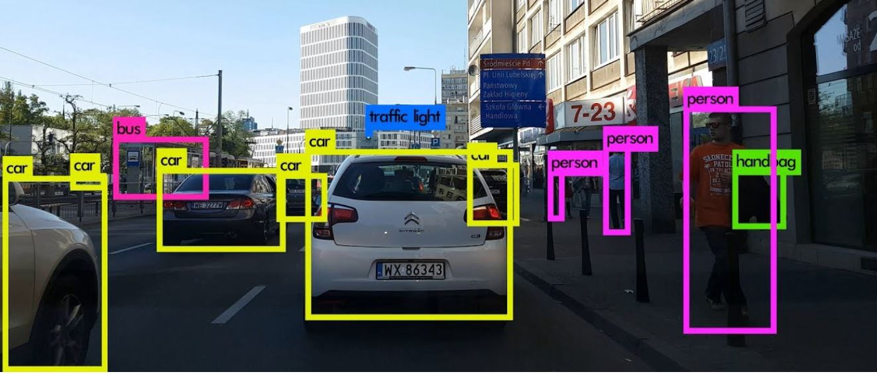
Introduction to object annotation model

Slide 3
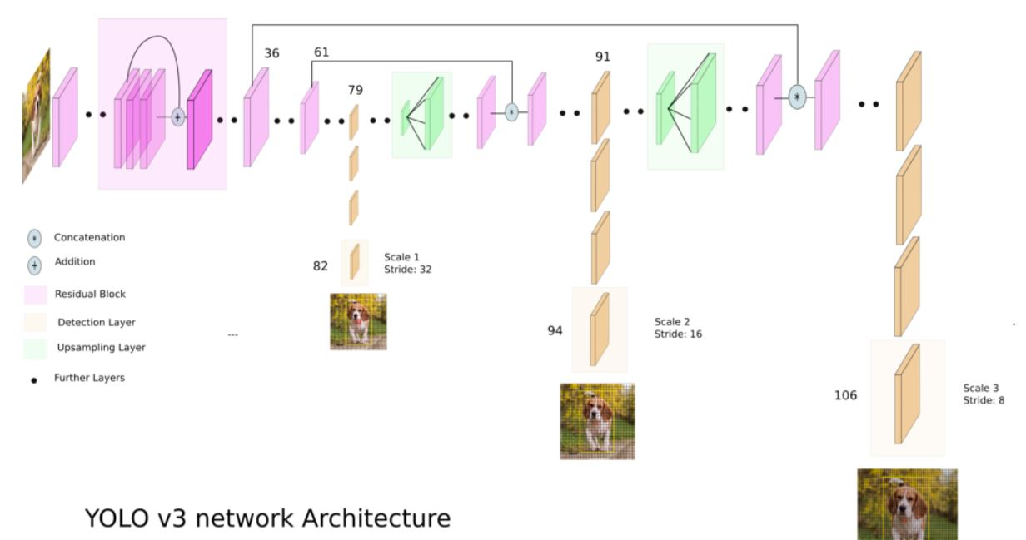
Yolo version 3 network architecture.

Slide 4
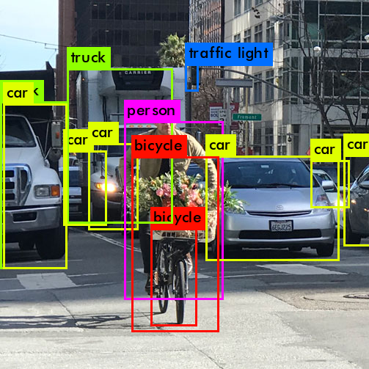
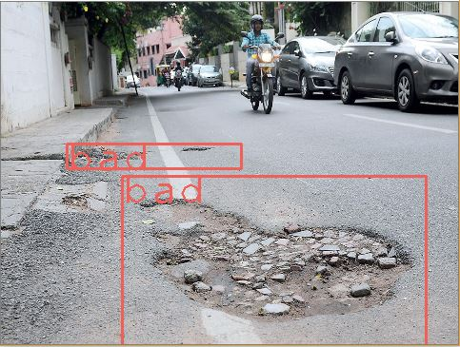
Making the model compatible with our problem.
Transfer Learning
Object Detection
Defect Detection

Slide 5
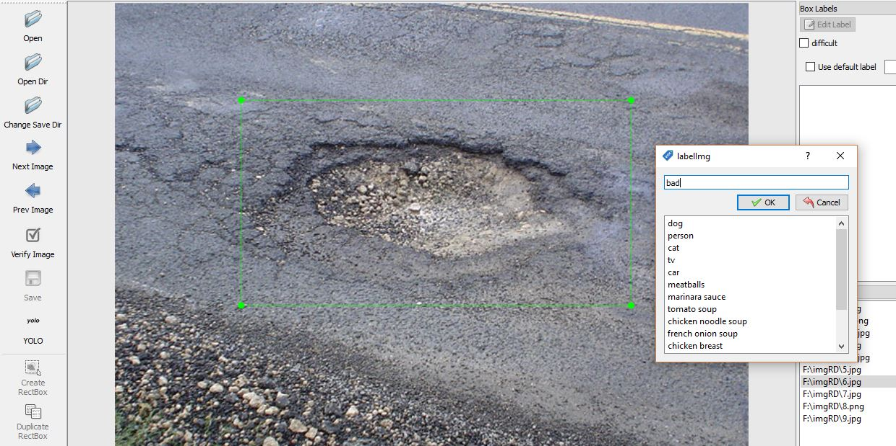
Now the time for training
Before sending data to the model, we have created only one class labeled as “bad” for defected roads.
Instead of training from the beginning, we used some pre-trained weights trained on the COCO dataset, which contained 80 classes to make our training faster.

Slide 6
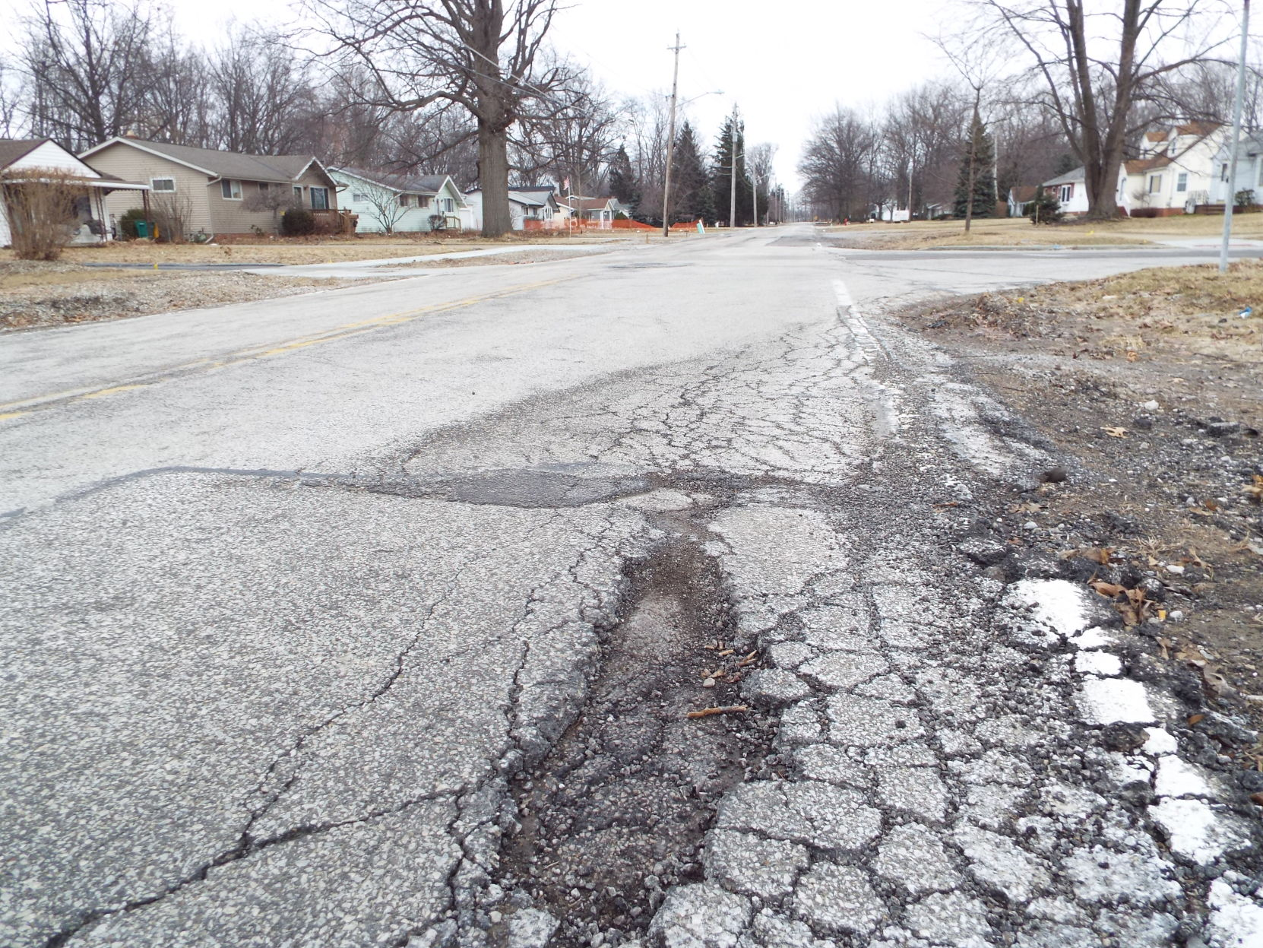
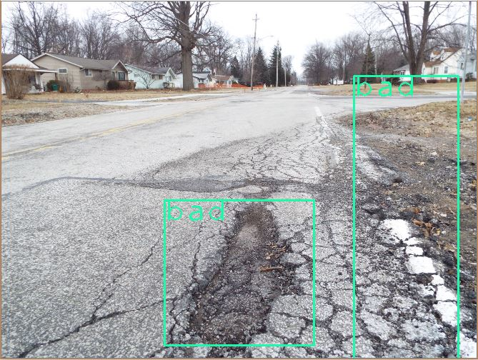
Now testing samples
Before annotation After annotation

Slide 7
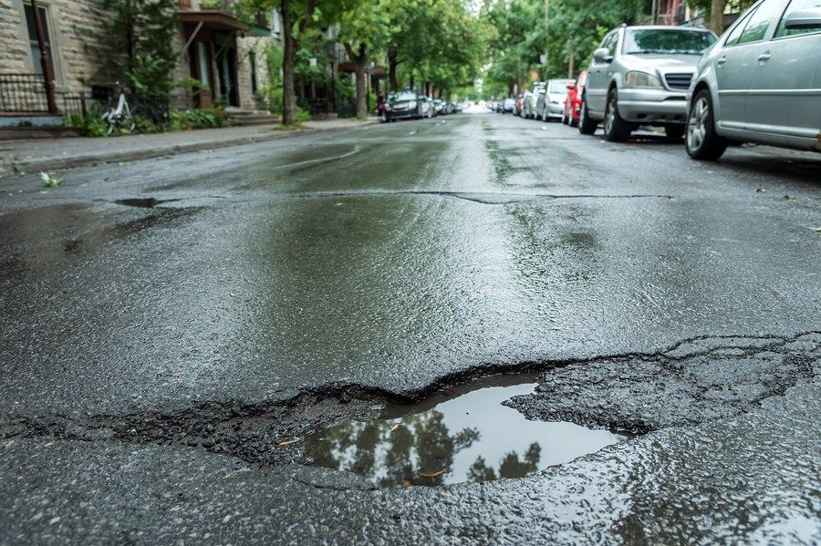
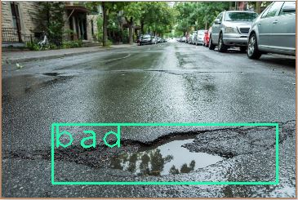
Testing cont’d
Before annotation After annotation

Slide 8
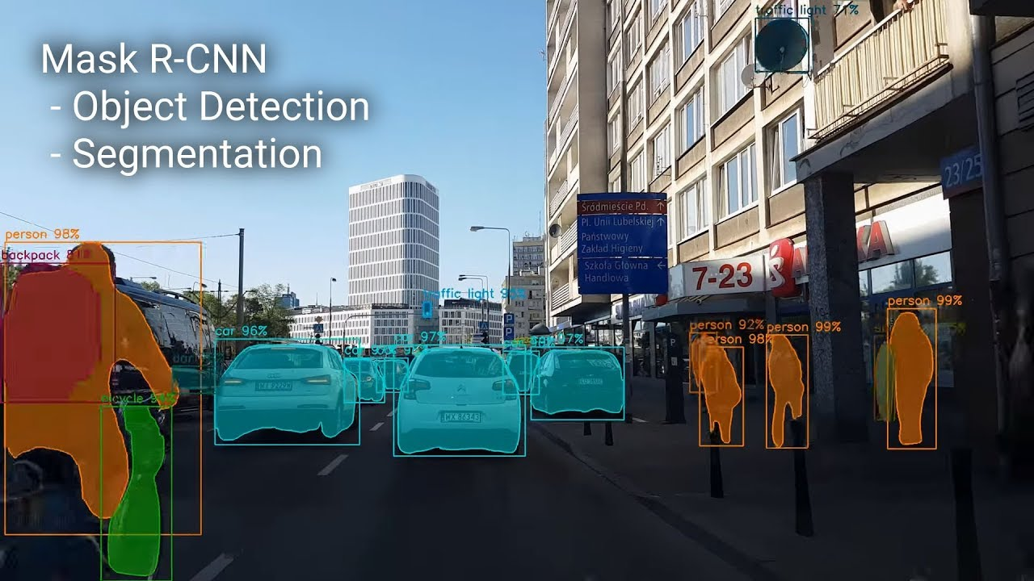
Introducing Mask R-CNN

Slide 9
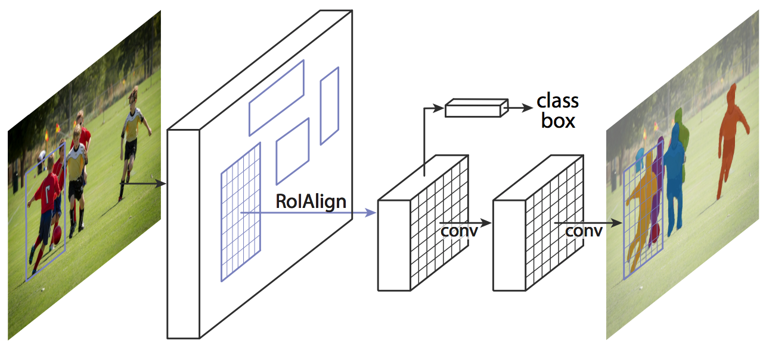
Introduction cont’d

Slide 10
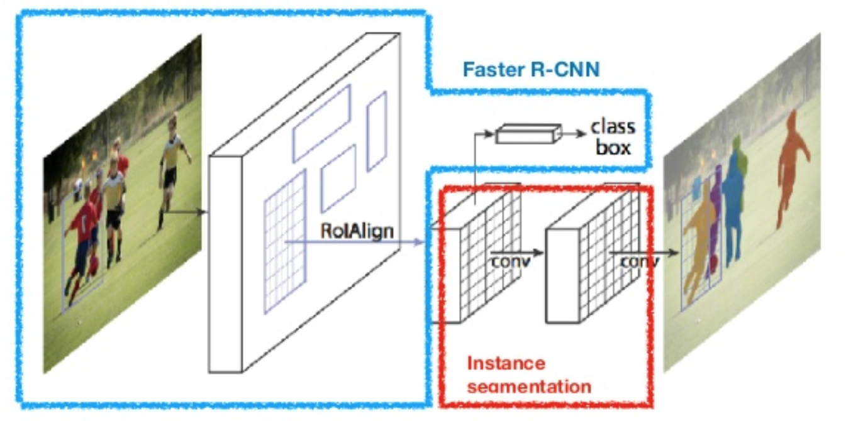
Parts of the Network

Slide 11
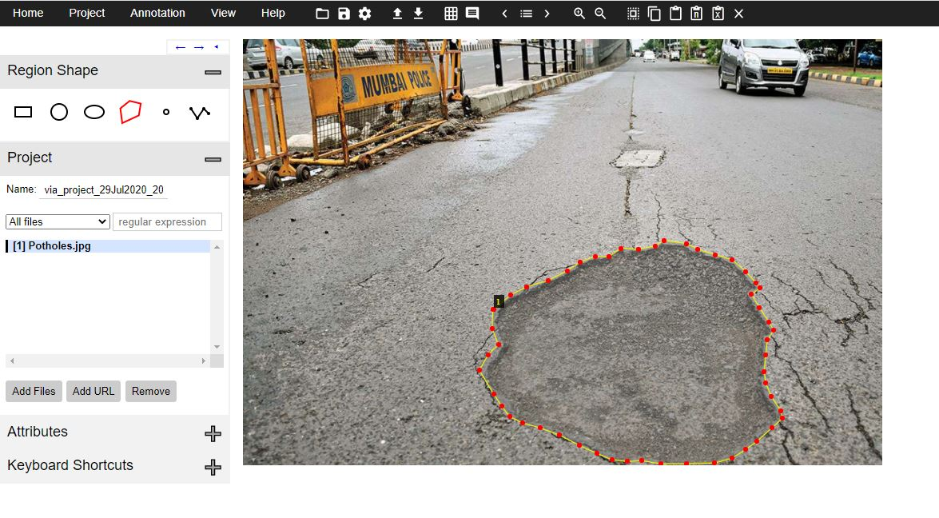
Preparing Dataset

Slide 12
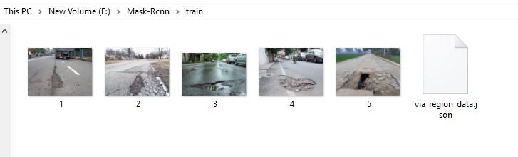
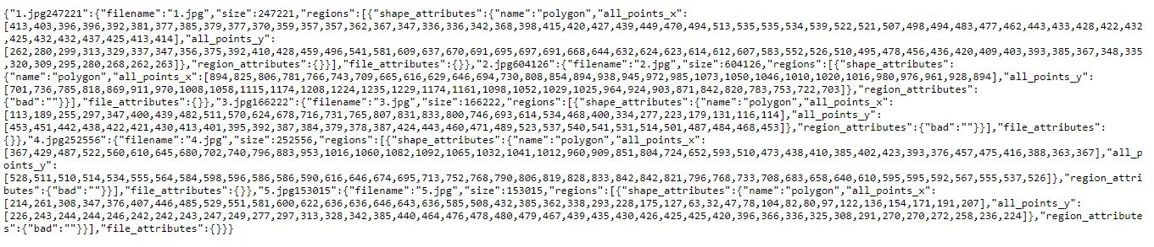
Datasets format

Slide 13
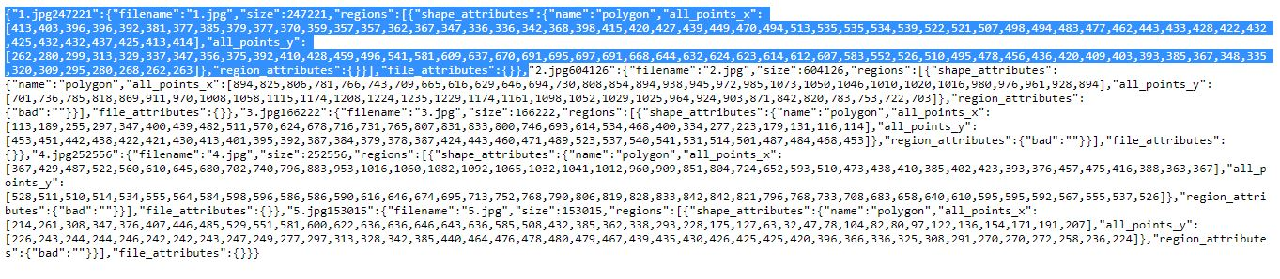
Datasets format Cont’d

Slide 14
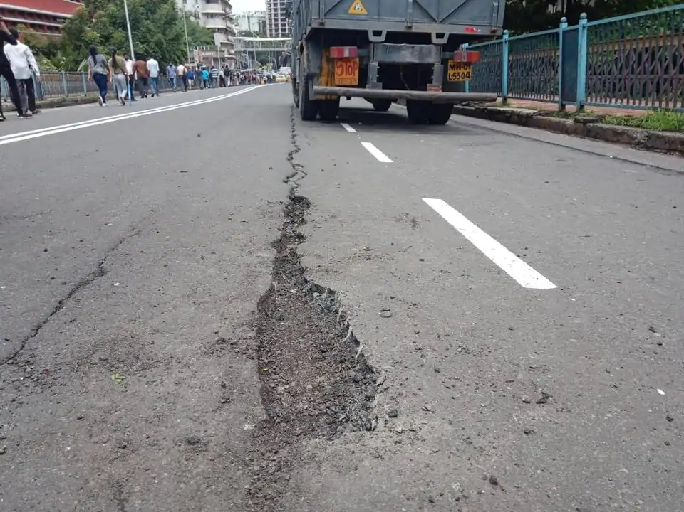
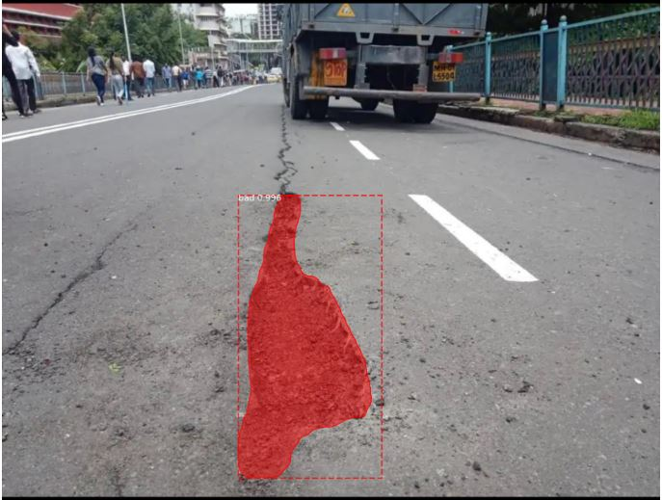
Now testing samples
Before annotation After annotation

Slide 15
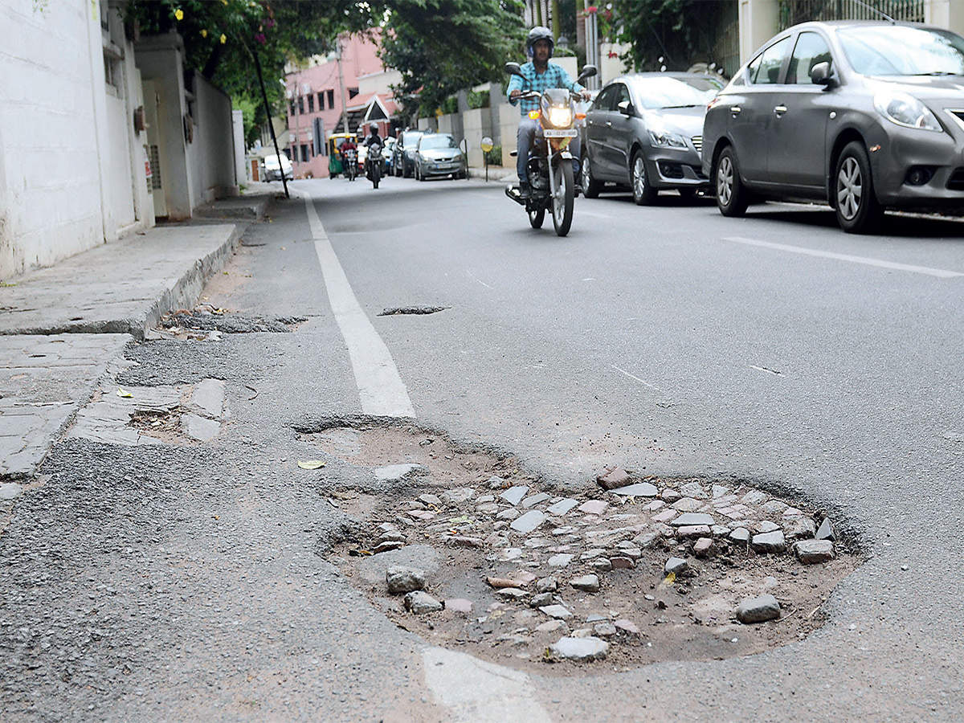
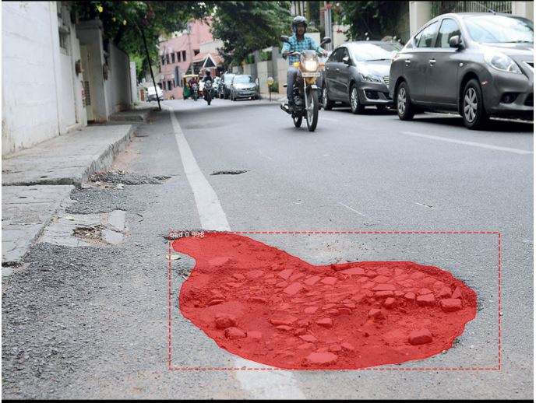
Now testing samples
Before annotation After annotation

Slide 16
The End! Thank You Everyone!

